Slide 1
Collections
Chapter-3

Slide 2
Collections
Collection framework provided by java.util package.
Represents a group of objects, known as its elements.
What is Collection Framework?
A collections framework is a unified architecture for representing and manipulating collections.
All collections frameworks contain the following:
Interfaces:
These are abstract data types that represent collections.
In object-oriented languages, interfaces generally form a hierarchy.
Implementations:
These are the concrete implementations of the collection interfaces.
Algorithms:
These are the methods of implementation classes, such as searching and sorting, on objects that implement collection interfaces.

Slide 3
The Collection interfaces
java.util.Collection is the root interface in the collections hierarchy.
The data structures derived from Collection interface are known as collections framework.
The collection interfaces determine the fundamental nature of the collection classes.
Collection is a generic interface with following declaration:
interface Collection <E>
// E specifies the type of objects that the collection will hold.
Collection extends the Iterable interface. This means that all collections can be cycled through by use of for-each style for loop.

Slide 4
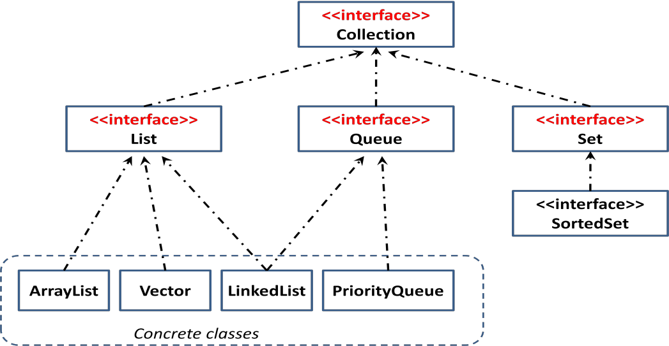
The Collection classes
The Collections Framework defines several interfaces as shown below.

Slide 5
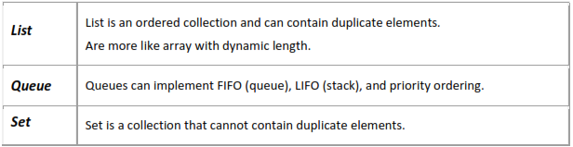
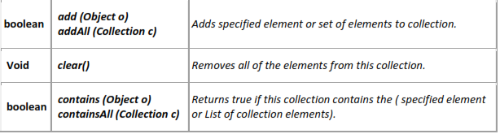
About each interface
Here is a list of the public methods of the Collection Interface.

Slide 6
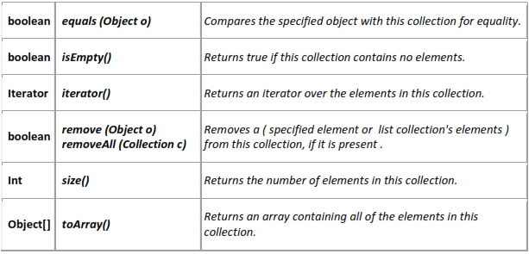

Slide 7
The collection interfaces packaged in java.util package
Interfaces | Description
Collections | Enables you to work with groups of objects
Dequeue | Extends Queue to handle a double-ended queue
List | Extends Collection to handle lists of objects
NavigableSet | Extends SortedSet to handle lists of objects
Queue | Extends Collection to handle Queues
Set | Extends Collection to handle sets
SortedSet | Extends Set to handle sorted sets

Slide 8
Iterator interface
Iterator
java.util.Iterator is an interface specifying the capabilities of an iterator.
iterator( ) method on a collection returns an iterator object that implements Iterator and knows how to step through the objects in the underlying collection.
The Iterator interface specifies the following methods:
hasNext() - Returns true if there are more elements in the collection; false otherwise
next() - Returns the next element
remove() - Removes from the collection the last element returned by the iterator

Slide 9
The Collections Classes
AbstractCollection
AbstractList
AbstractQueue
AbstractSet
ArrayList
ArrayDeque
EnumSet
LinkedList
PriorityQueue
TreeSet
HashSet

Slide 10
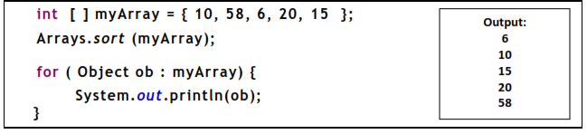
The Array class
The Arrays class provides various methods that are useful when working with arrays.
These methods help bridge the gap between collections and arrays.
The sort( ) method sorts an array so that it is arranged in ascending order.

